Slide 1
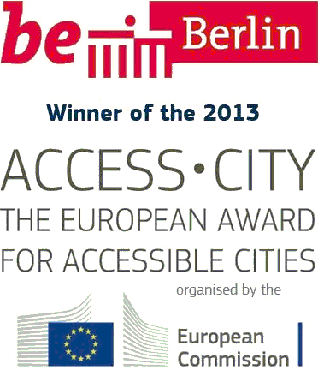
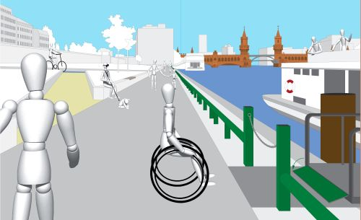
Symposium
The New Urban Agenda: implementing sustainable urban development in a way that is inclusive and barrier-free, 26 June 2017
Barbara Berninger
Senate Department for the Environment, Transport and Climate Protection, Berlin
Ingeborg Stude
Senate Department for Urban Development and Housing, Berlin

Slide 2
New Urban Agenda
The Governing Mayor of Berlin is the spokesperson for the METROPOLIS network in the HABITAT III process
Strengthening the role of cities as actors in the HABITAT III process
Cities as key actors in the implementation of the goals of “inclusive cities”

Slide 3
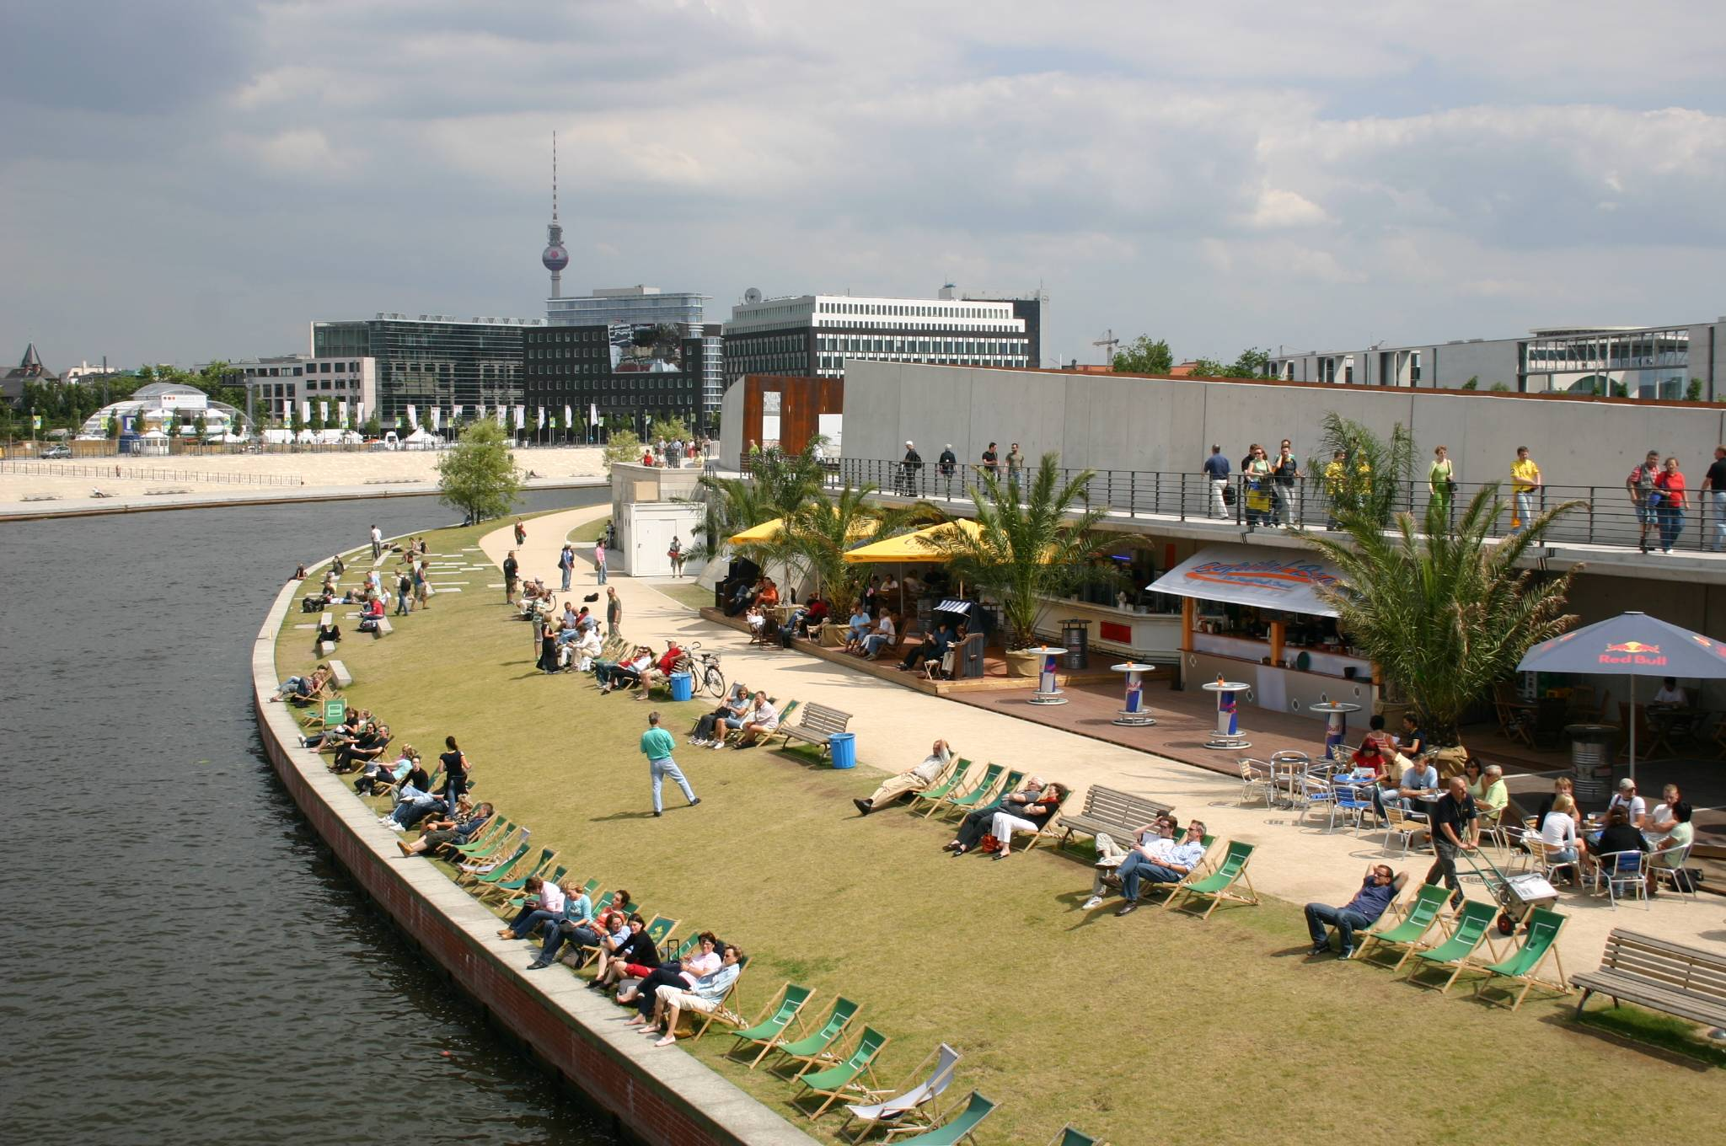
Berlin – City for All

Slide 4
On 12th May 2015, the Berlin Senate passed its “Details about the 10 guidelines on disability policy of the federal state of Berlin for the sustainable implementation of the UN Convention on the Rights of People with Disabilities by 2020” in respect of the following topic areas:
Awareness-raising
Accessibility
Education and inclusive schools
Work/employment
Participation and involvement
Self-determination
Equal treatment

Slide 5
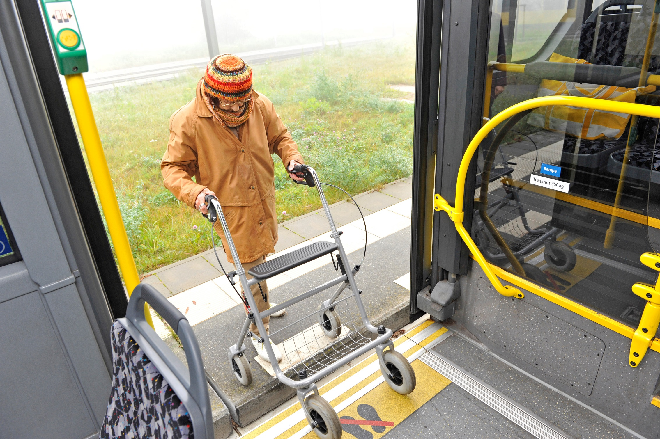
Comfortable for All

Slide 6
Mobility Programme 2016
The goal of the Senate Department for Urban Development is to create equal opportunities for mobility for all Berlin inhabitants. This applies in particular to elderly persons and persons with disabilities.
Accessible routes for pedestrians
Low kerbs at main crossroads
Tactile guidance systems at crossroads
Acoustic signals at traffic lights
Mobility Program 2016

Slide 7
EUROCITIES
Working Group Barrier-free City for All

Slide 8
EUROCITIES Working Group “Barrier-free City for All”
Aims:
To network with regard to European strategies and initiatives on the subject of accessibility
To exchange experience about examples of good practice with regard to improving accessibility
To carry developments forward in both conceptual and practical terms in the area of the “barrier-free city”

Slide 9
“Concept Accessibility” Tool for the construction process
June 2017
dipl.ing. ingeborg stude berlin

Slide 10
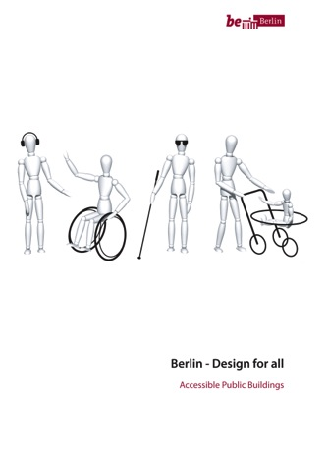
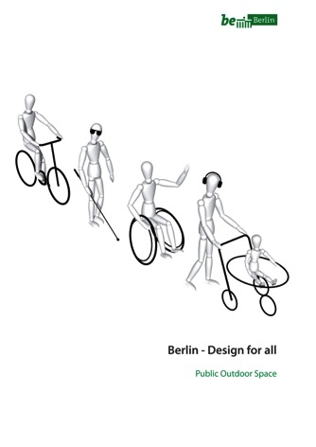
Manuals (Binding requirements for all construction projects of the Federal State of Berlin)
Berlin-Design for all – Accessible Public Buildings | 2nd Edition, 2012
Berlin-Design for all – Public Outdoor Spaces | 2nd Edition, 2011
Editor
Senate Department for Urban Development and Housing,
Berlin
TU Berlin, FB Modell + Design

Slide 11
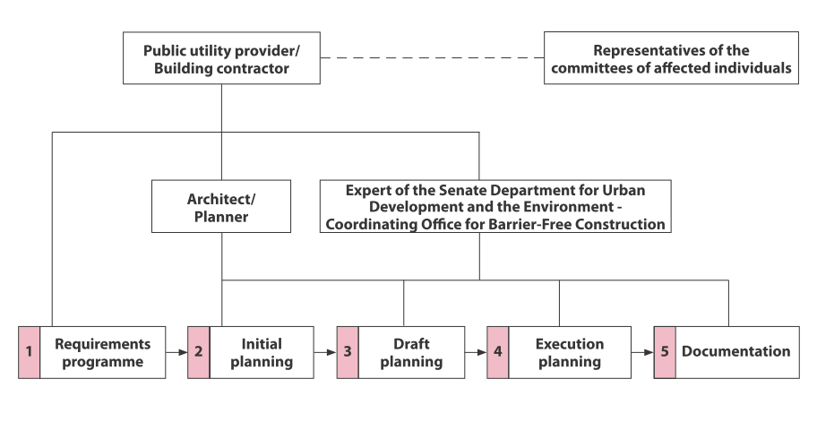
Responsibilities in the construction process

Slide 12
IGA 2017 BERLIN
Complexity and sustainability of Design for All
dipl. ing. ingeborg stude, senate department for urban development and housing

Slide 13
IGA 2017 BERLIN
Transport links
Signage
Public spaces
Buildings
Events
Komplexität und Nachhaltigkeit im Design for All dipl. ing. ingeborg stude, senatsverwaltung für Stadentwicklung und wohnen

Slide 14
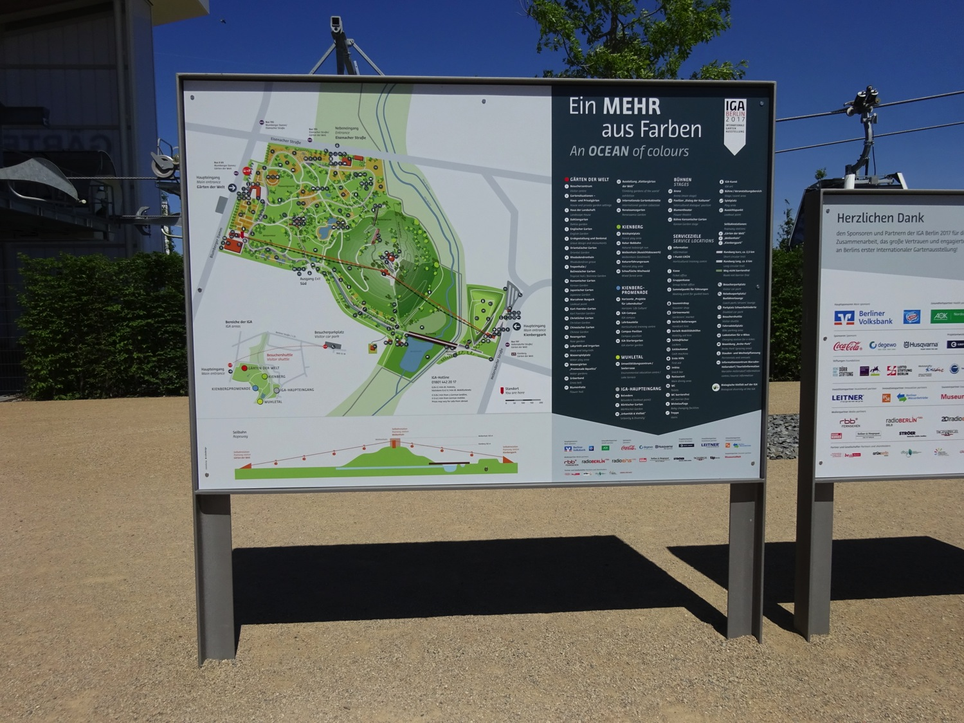
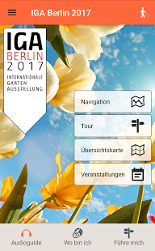
Signage
analogue virtual

Slide 15
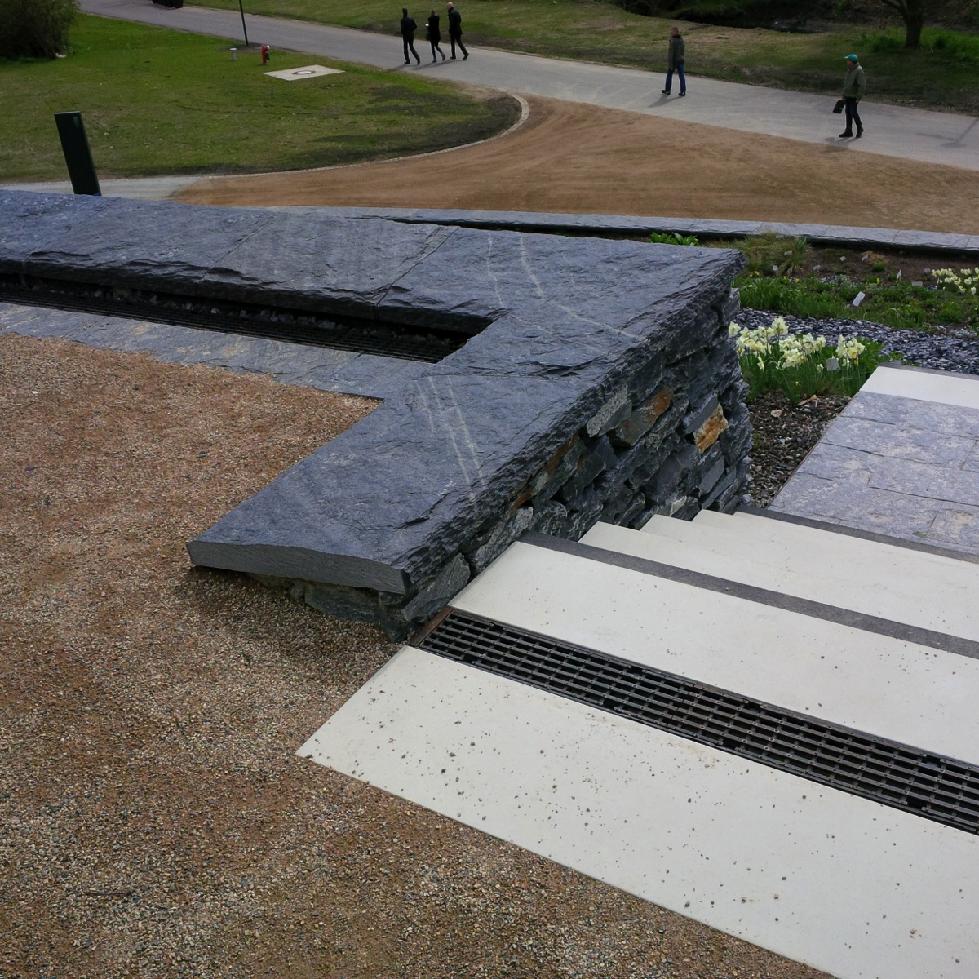
NATURE
and
Art of Architecture
CONTRAST
Tactile
Visual
Safe!

Slide 16
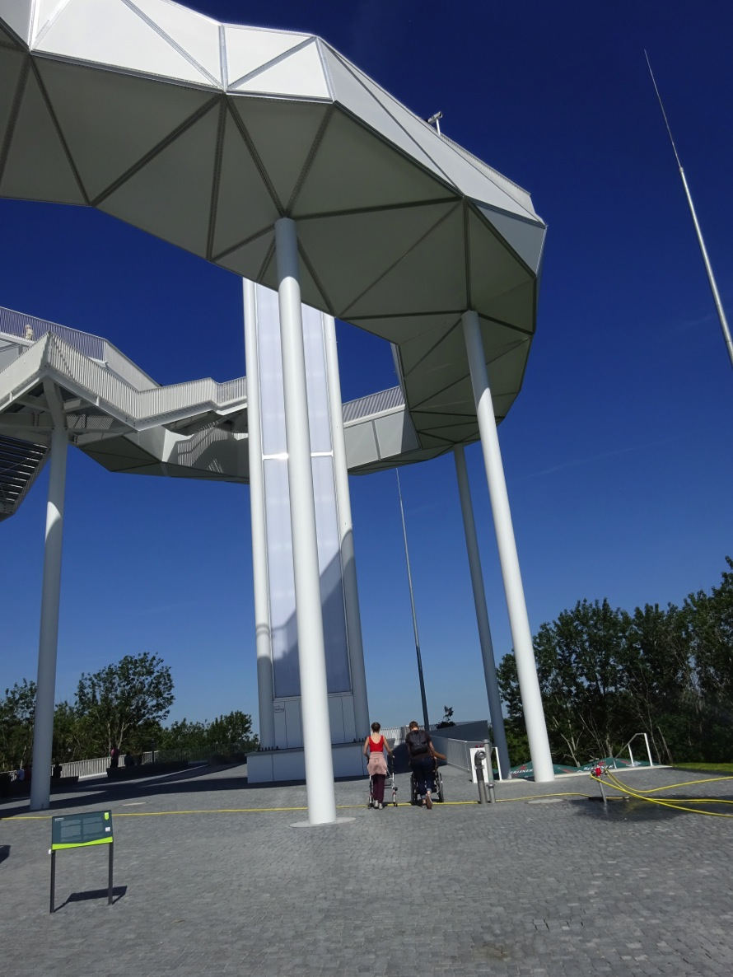
WOLKENHAIN
(observation tower)

Slide 17
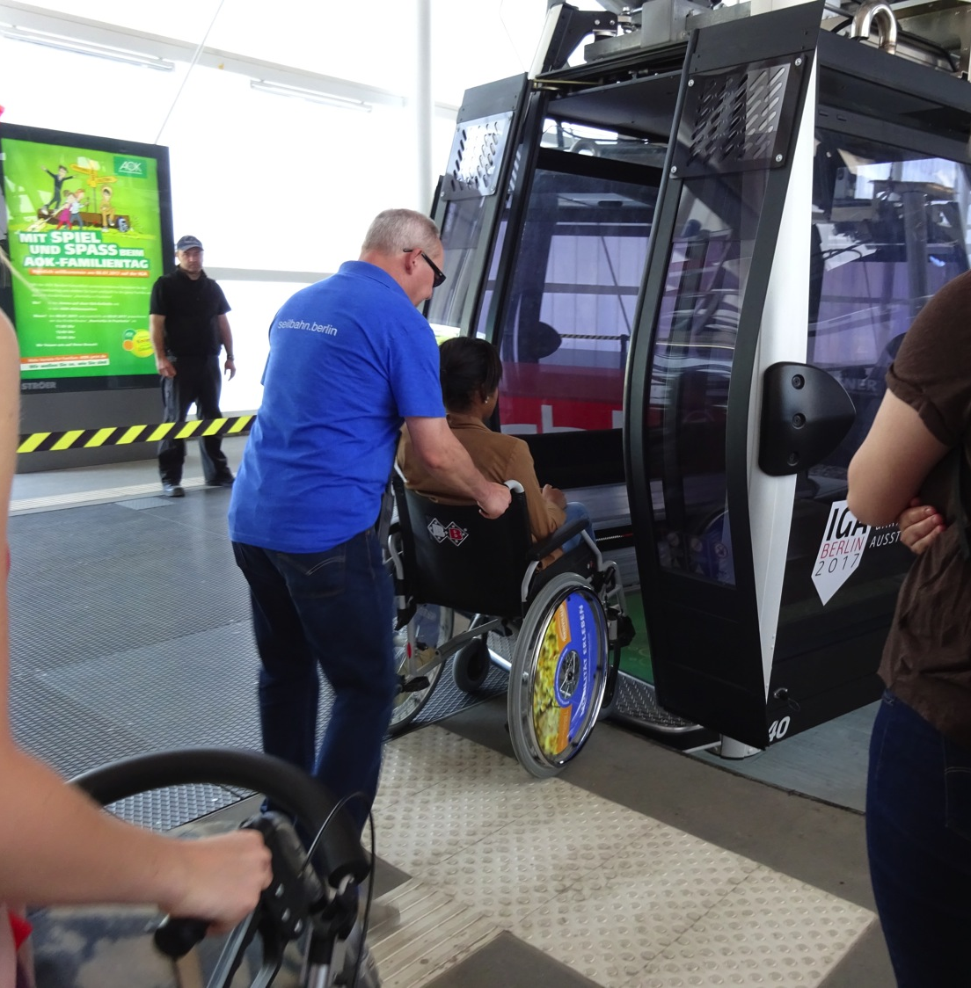
CABLE CAR
Slow
Flat
Considerate

Slide 18
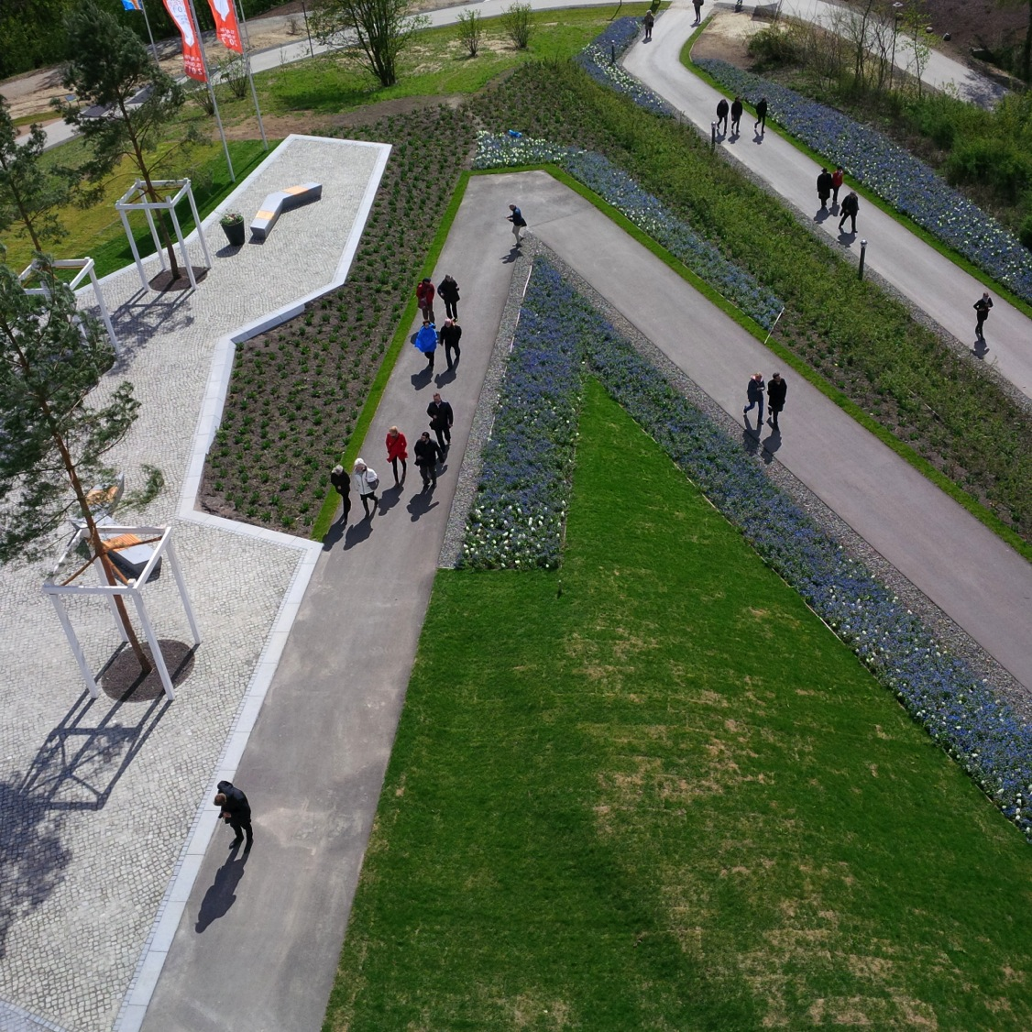
PANORAMIC VIEWPOINTS
NATURE
Colour
Shape
Texture

Slide 19
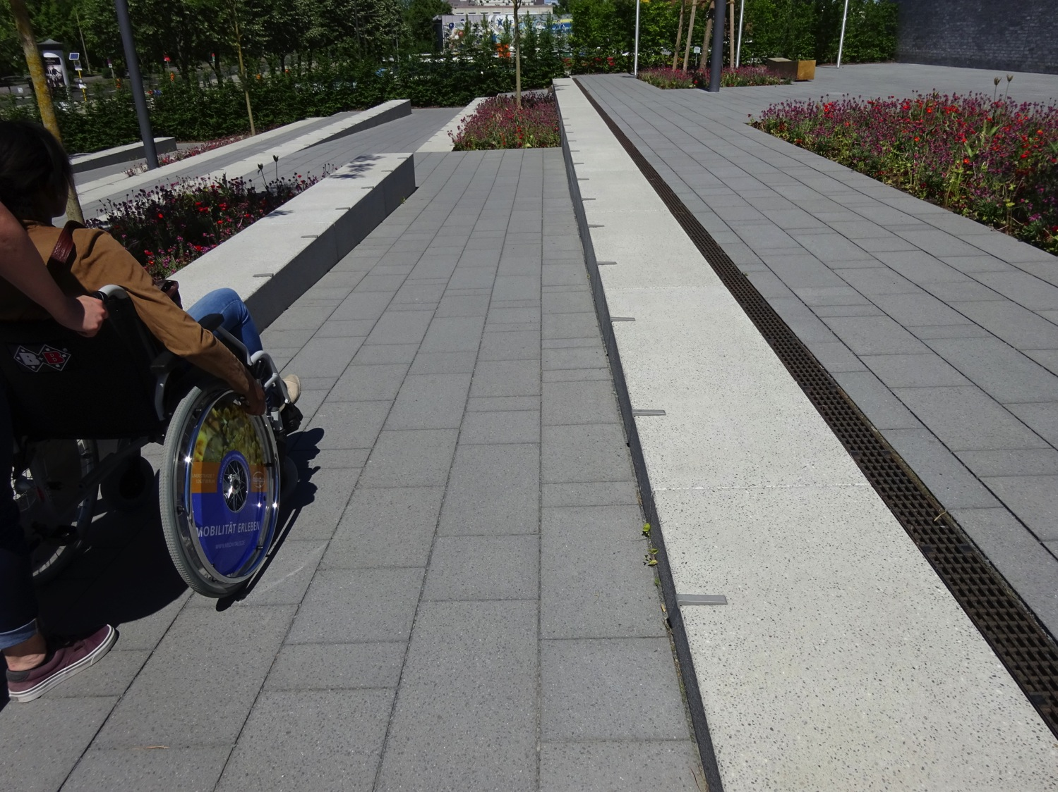
Details

Slide 20
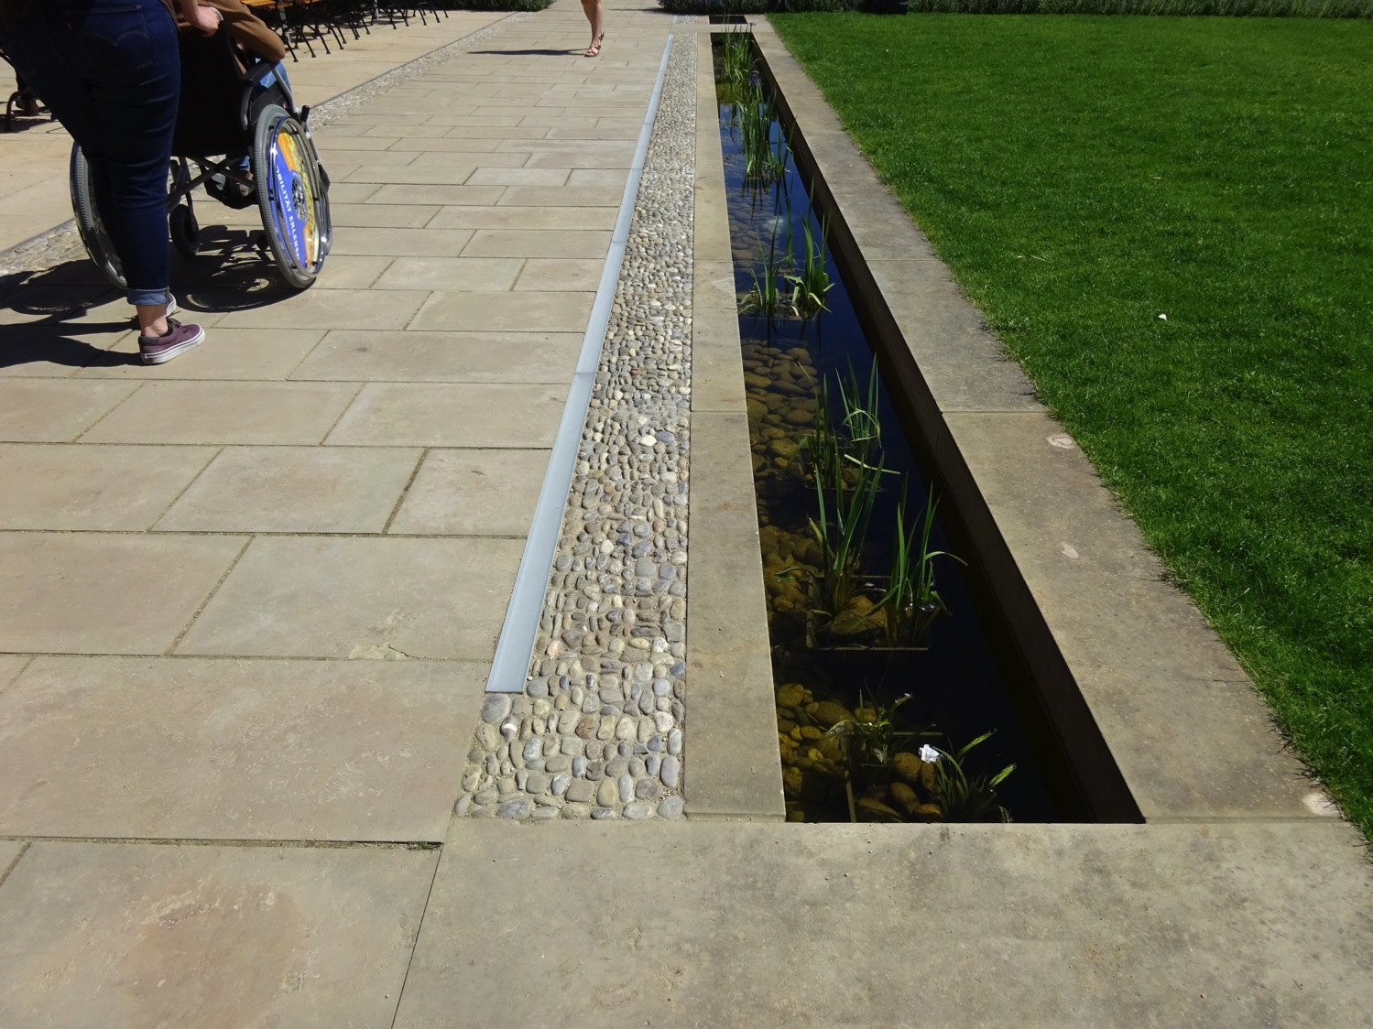

Slide 21
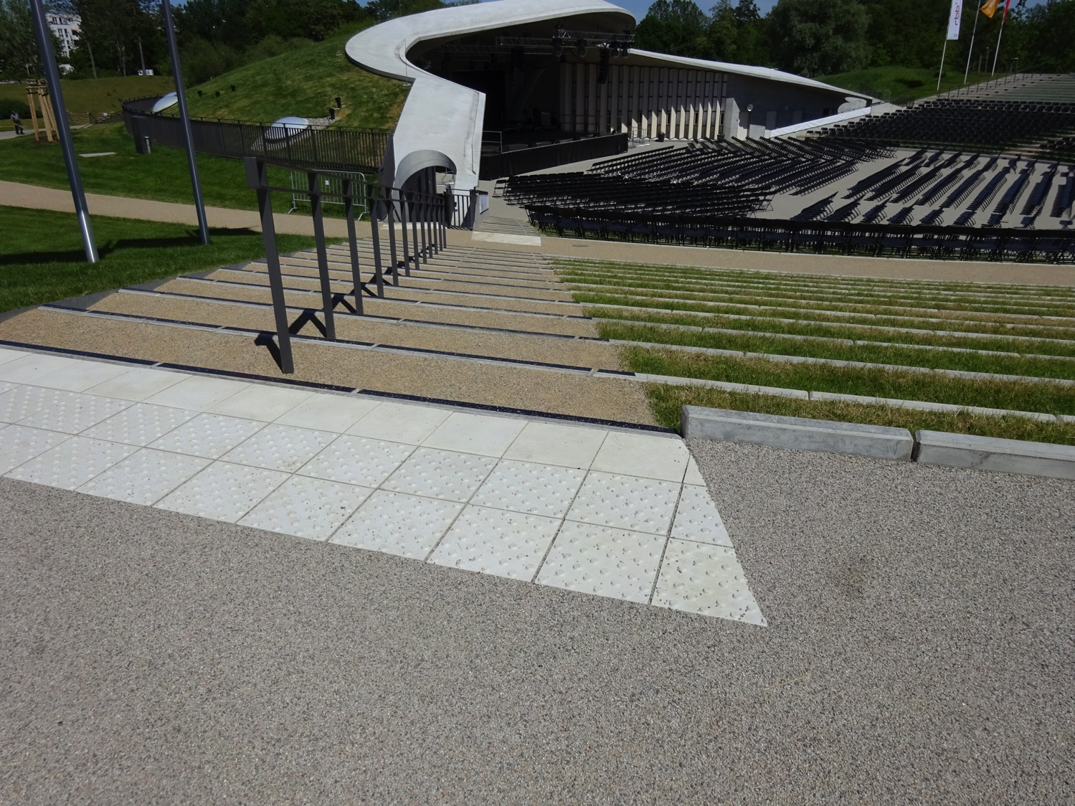

Slide 22
Questions?
Barbara Berninger
Senate Department for the Environment, Transport and Climate Protection, Berlin
Mail: Barbara.Berninger@SenUVK.berlin.de
www.berlin.de/sen/uvk/
Ingeborg Stude
Senate Department for Urban Development and Housing, Berlin
Mail: Ingeborg.Stude@SenSW.berlin.de
www.stadtentwicklung.berlin.de

