Slide 2
RIOinclui - The Social Works of the City of Rio de Janeiro (OSCRJ), is a civil, philanthropic, non profitable organization, chaired by the City hall’s First Lady, which focuses in people with disabilities in a situation of social vulnerability, especially children and adolescents.
WHO WE ARE
Improve life conditions of people with disabilities through the renovation of their homes, focusing in the accessibility, and social support. Moreover, we promote actions of social awareness and establish articulations with institutions which operate in the same area, aiming to ensure the rights of the children and adolescents with disabilities.
MISSION
RIOinclui has its actions scaled in three main axes: implementation of projects, establishing contacts among social actors and the development of actions of social awareness.
ACTIONS
Notes:
2

Slide 3
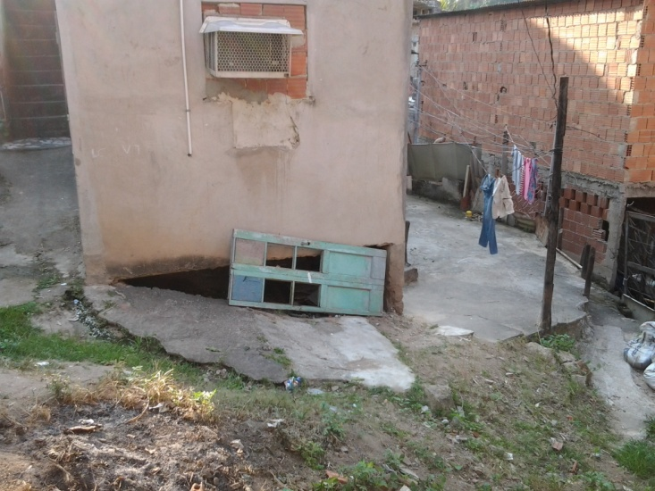
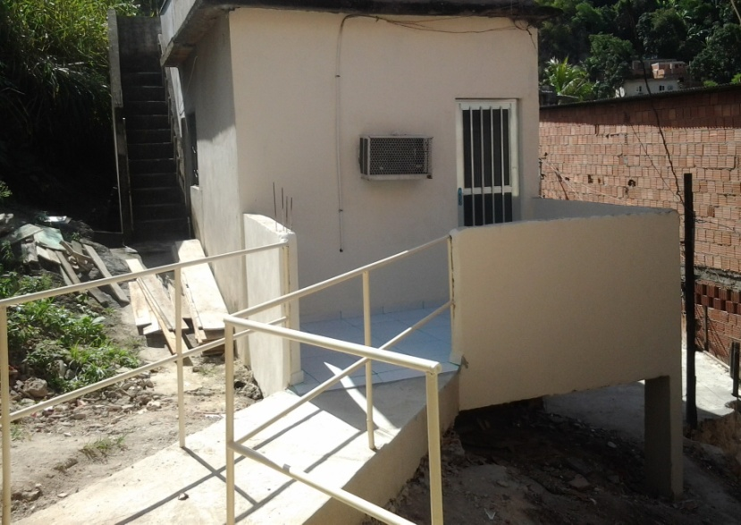
PROGRAM HOUSING AND ACCESS
Combining architecture, universal design and social work, RIOinclui provides accessible housing for children and adolescents with disabilities living in poor conditions in the city of Rio de Janeiro. Targeting physical and social mobility at the same time, the project goes beyond architectural interventions: reasonable accommodation for the beneficiaries and their care-givers is created. The whole family is empowered to benefit from statutory social welfare; a network of local support is provided.

Slide 4
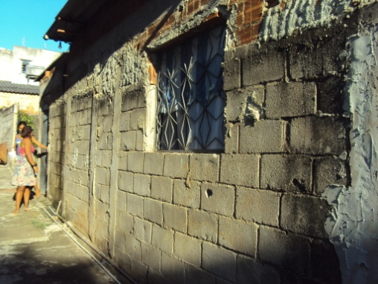
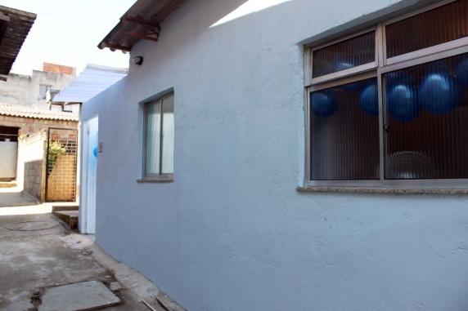
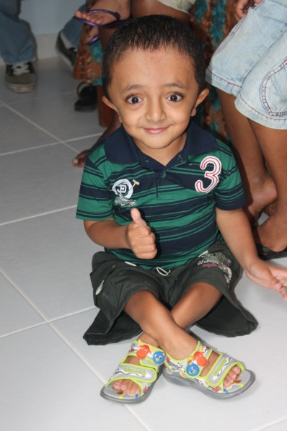
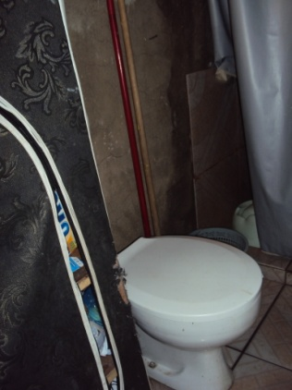
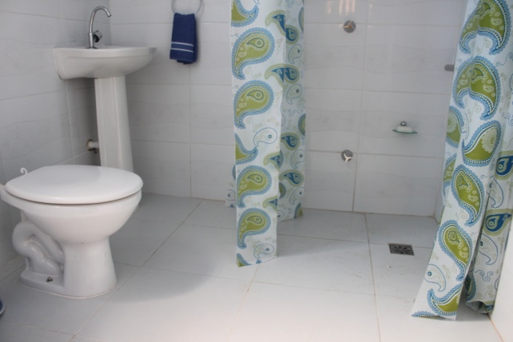
GENERAL PURPOSE
Broaden the conditions of accessibility to people with disabilities, living in low income communities in the city of Rio de Janeiro.

Slide 5
SPECIFIC GOALS
1 – The architectural renovation of the house of people with disabilities, living in a situation of social vulnerability in the City of Rio de Janeiro, aiming to ensure their accessibility;
2 – To elaborate a social study of each family or group served by the Project;
3 – Expand the possibilities of social inclusion of people with disabilities and their families living in a situation of social vulnerability in the City of Rio de Janeiro.

Slide 6
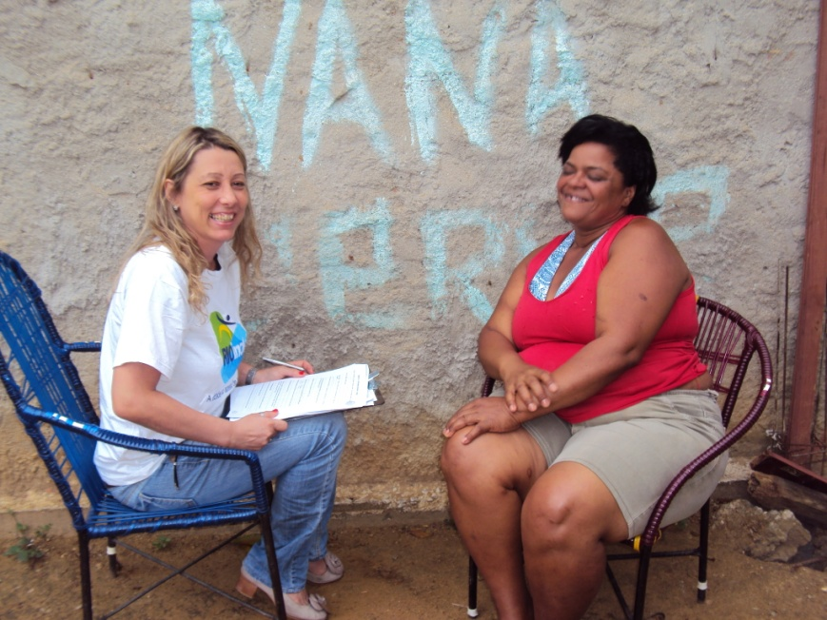
THE INTERDISCIPLINARY STAFF
A social worker, an architect who is also the administrator of Program Housing and Access, together with teams of masons working directly in the implementation of the Program Housing and Access, performing the renovation work, according to the planning staff.

Slide 7
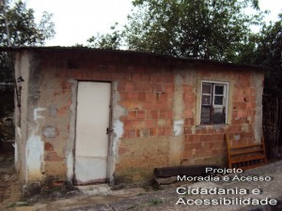
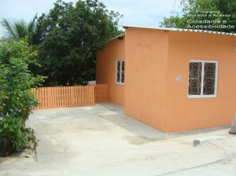
CURRENT SITUATION & OUTLOOK
RIOinclui’s main focus areas are architecture and social service. For example, a house that was built in rugged terrain prevented a child with severe motor disability ( wheelchair user) from getting out of her home. The construction of a platform allowed her access to the community and to go to school. Technical knowledge of accessibility, from the nexus of architecture and social service, can be replicated in any work that seeks to guarantee human rights to people with disabilities.

Slide 8
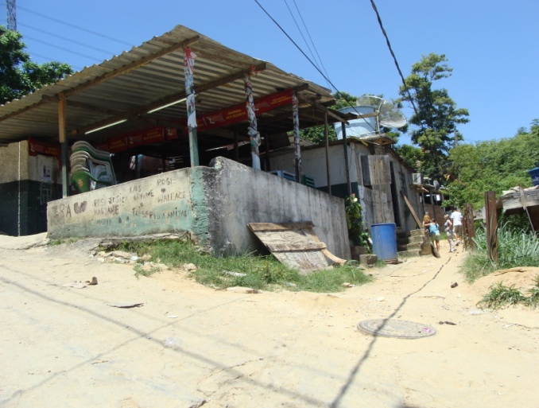
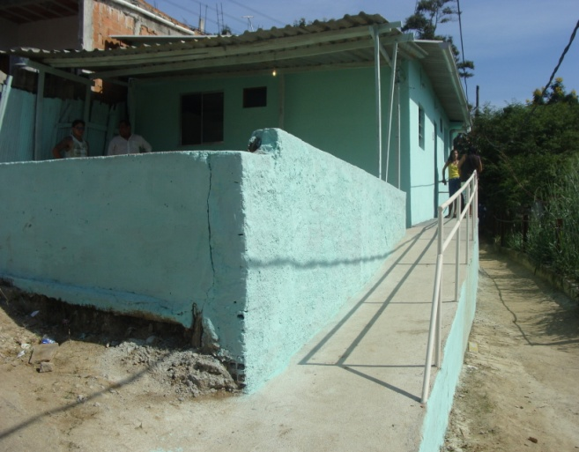
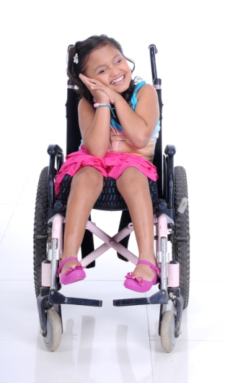
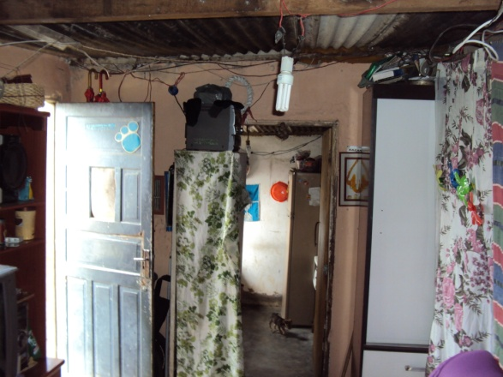
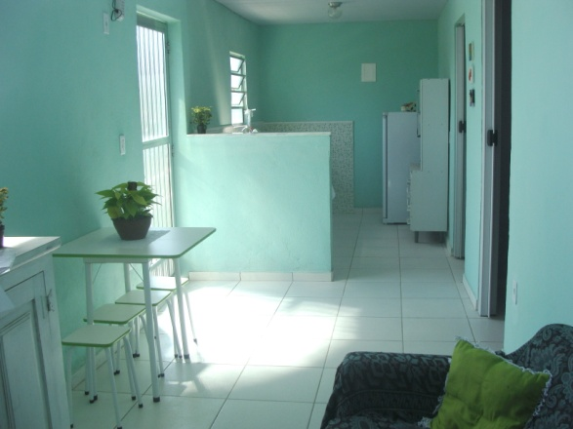
CURRENT SITUATION & OUTLOOK
.

Slide 9
ABOUT THE PROGRAM IMPACTS
Improvement of living conditions of the beneficiary with disabilities and consequently their interaction with the new environment adapted and healthy;
Improve the functionality of children and adolescents with disabilities in terms of ICF (WHO), due to proper architectural structure;
Considering that: "Housing is not only the cement structure, is a gateway to other social rights such as education and health", as stated by Raquel Rolnik, our program helps to improve the child and adolescents with disabilities self-government .

Slide 10
CONTACT
Mrs. Isabel Cristina Pessôa Gimenes
gimenes.isabel@gmail.com
Facebook/rioinclui
+55 21 2976 9164
Thank you

